Slide 1
The War is Over
Part 2

Slide 2
As soldiers arrived home, the railway station was decorated with flags and fresh tree branches.

Slide 3
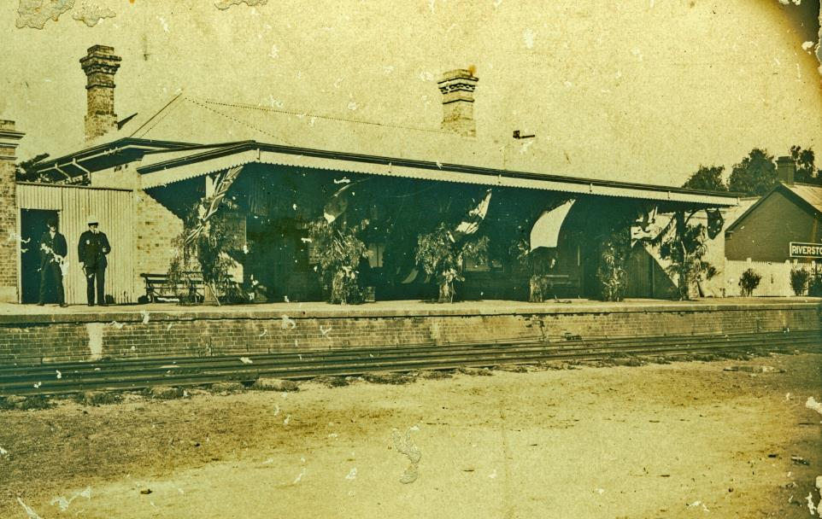

Slide 4
Homes were decorated with flags and signs.
Families and friends gathered to celebrate.

Slide 5
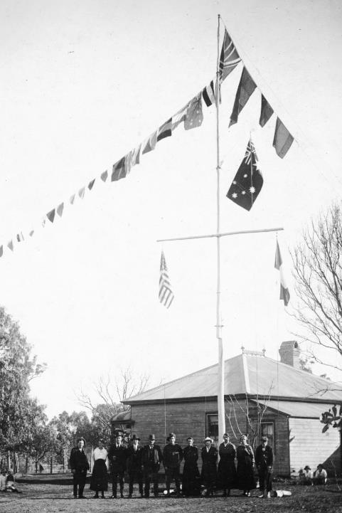
The Towers family home decorated for the return of John Towers.

Slide 6
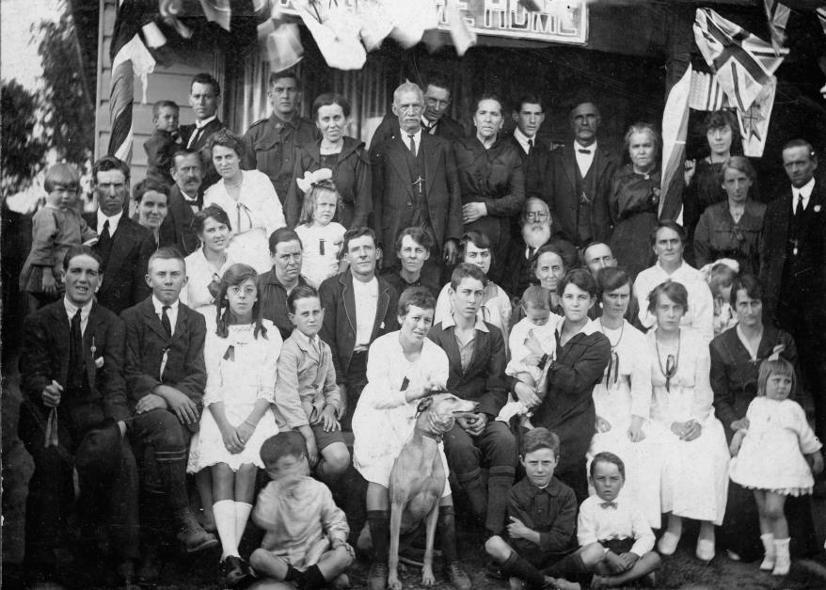
Even the greyhound came to the Turner event.

Slide 7
The Riverstone war memorial was unveiled on
8 November 1919.

Slide 8
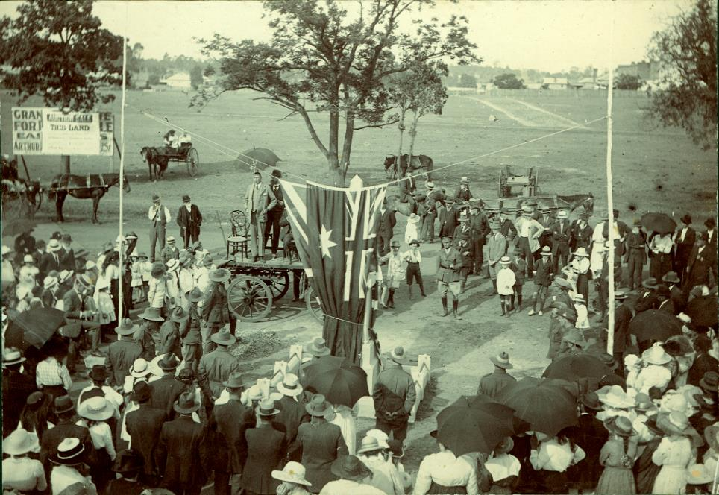

Slide 9
On 18 July 1919 school students at Riverstone were presented with peace medals.

Slide 10
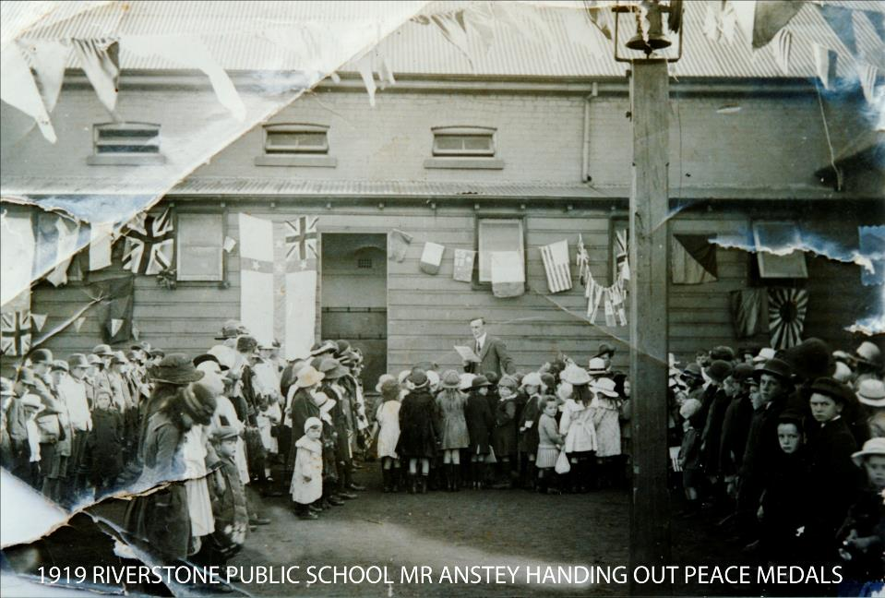

Slide 11
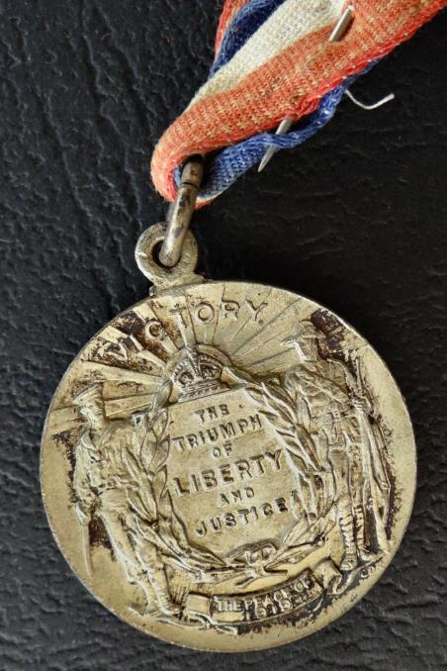
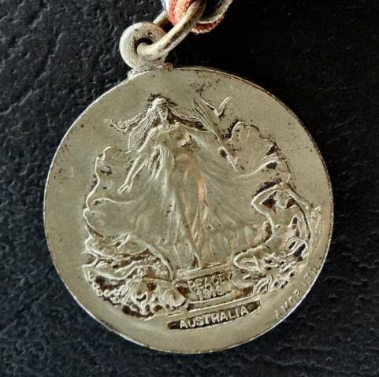
One of the medals handed out.

Slide 12
In 1919 the returned servicemen were presented with medallions from the local community.

Slide 13
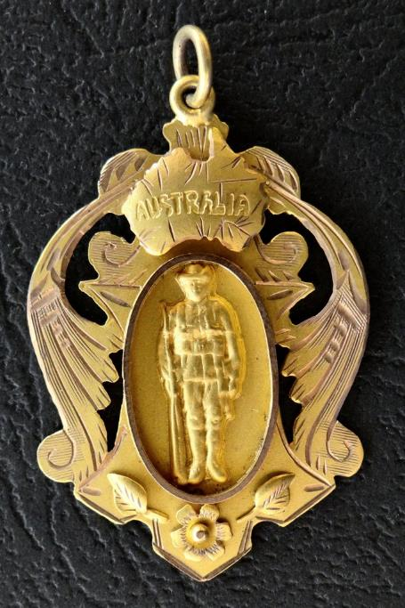
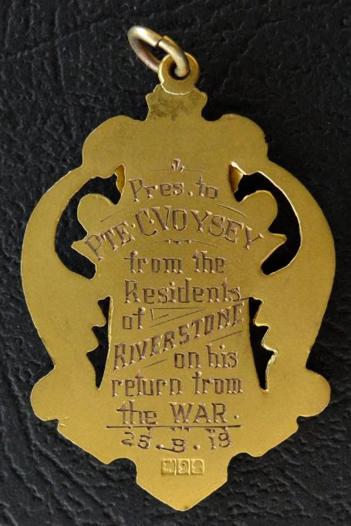

Slide 14
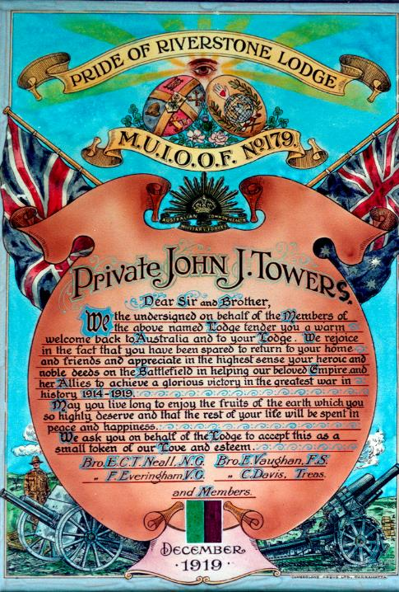
Organisations recognised the service of their members.

Slide 15
In 1920 the work of 34 local women was recognised when they were presented with a specially framed collection of photographs.

Slide 16
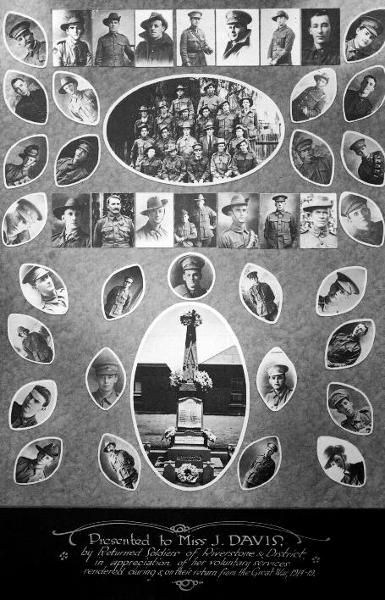

Slide 17
The bottom half featured the war memorial surrounded by photos of some of the men who died.

Slide 18
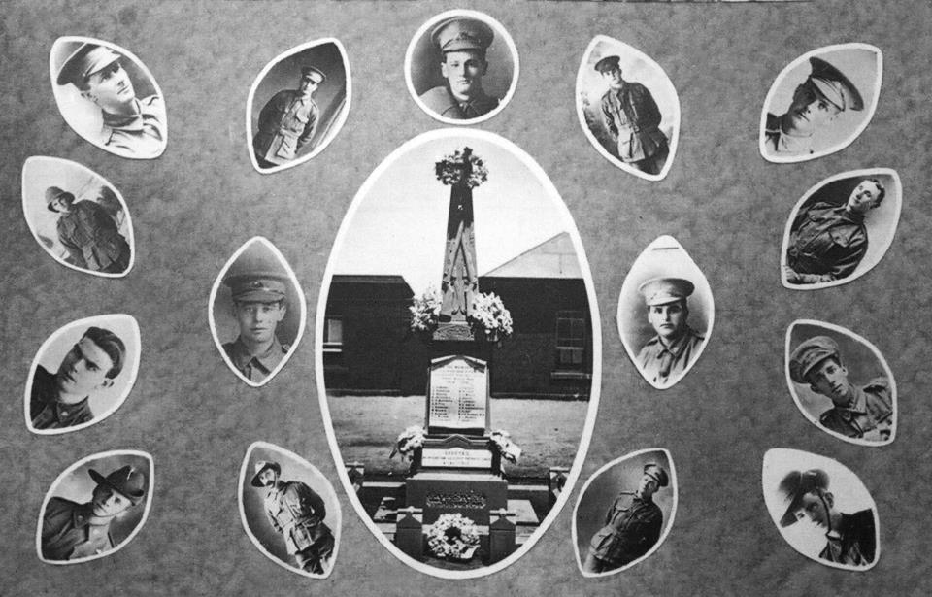

Slide 19
The names of 22 men who died are listed on the First World War panel on the Cenotaph at Riverstone.

Slide 20
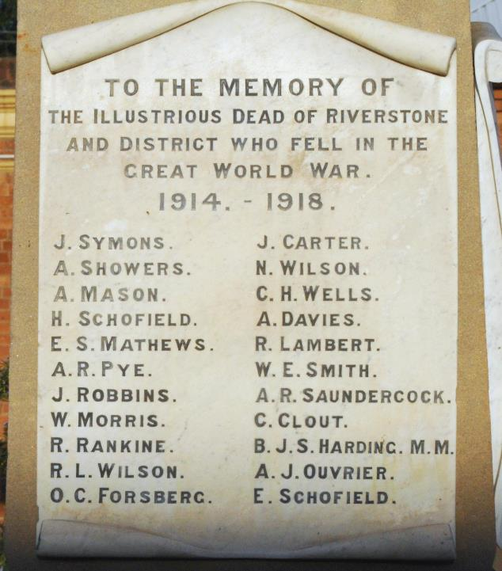

Slide 21
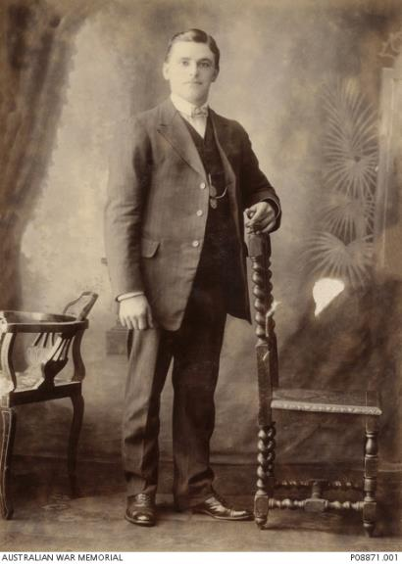
Joseph Carter

Slide 22
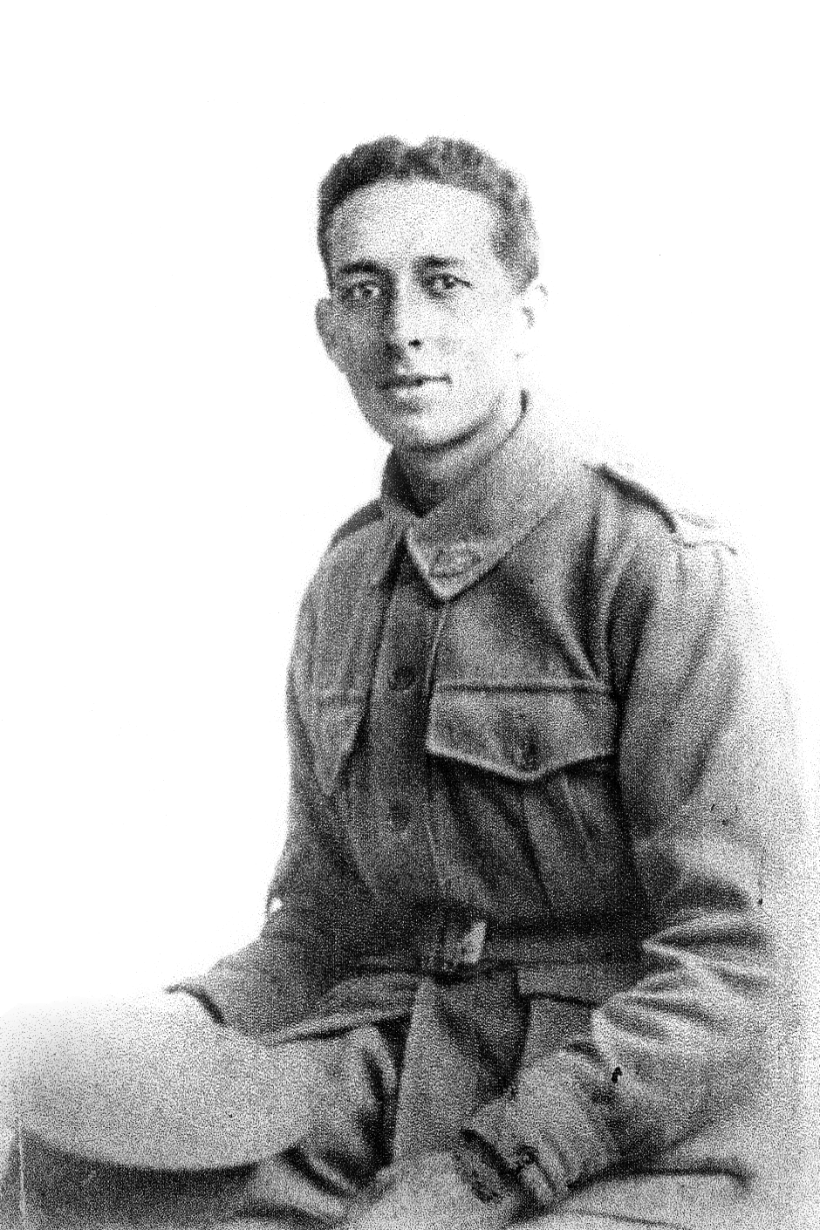
Thomas Davies

Slide 23
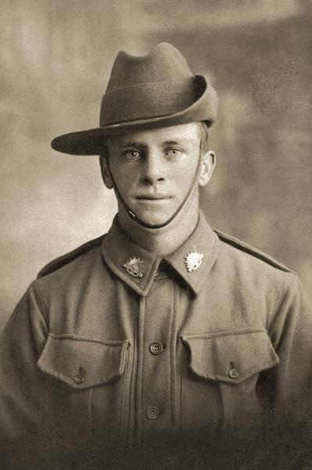
Ambrose Mason

Slide 24
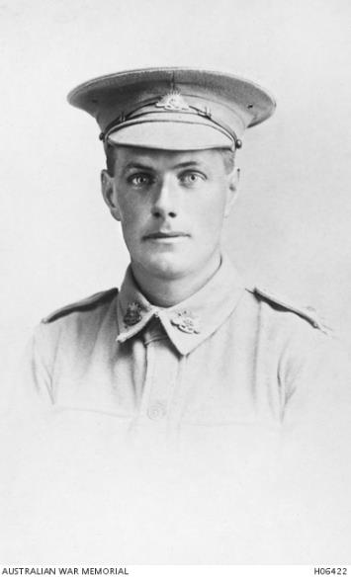
Eric Mathews

Slide 25
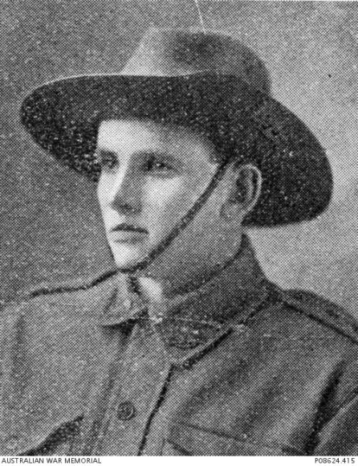
William Morris

Slide 26
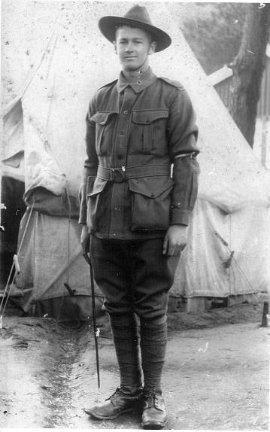
Alfred Pye

Slide 27
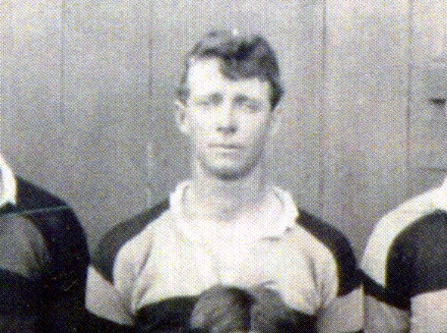
Robert Rankine

Slide 28
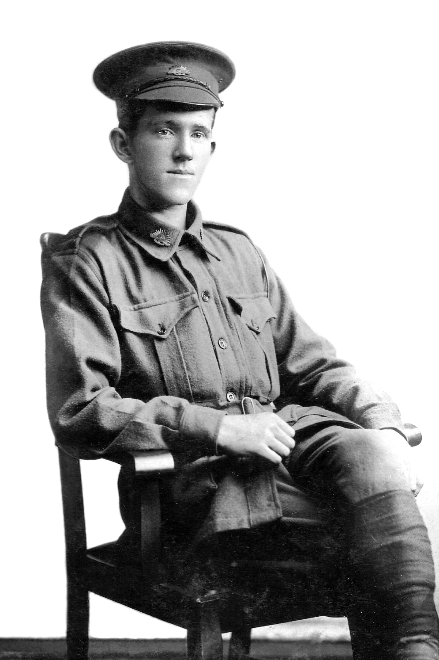
Alexander Saundercock

Slide 29
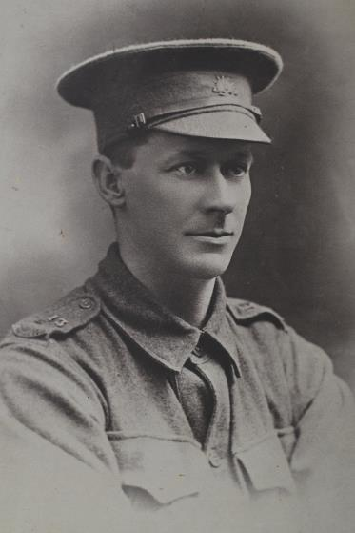
Edwin Schofield

Slide 30
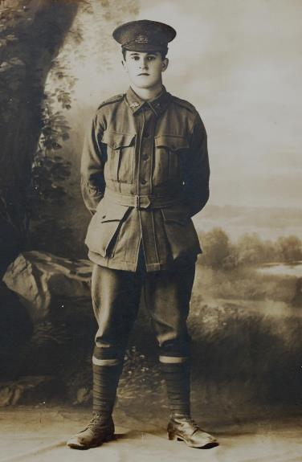
Horace Schofield

Slide 31
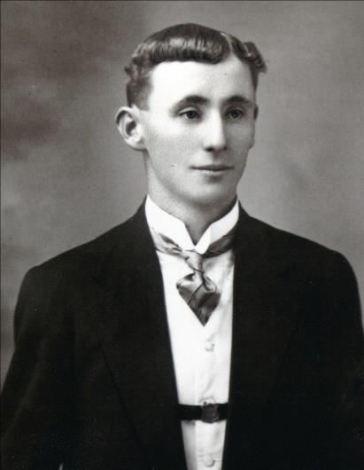
James Symons

Slide 32
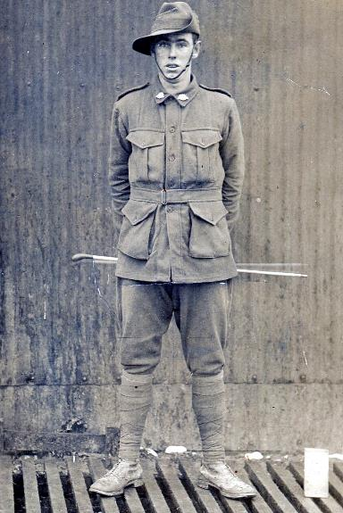
Charles Wells

Slide 33
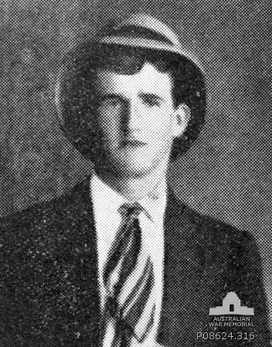
Robert Wilson

Slide 34
Cyrus Clout Oroya Forssberg Bertie Harding Roy Lambert Alfred Ouvrier John Robbins Archibald Showers William Smith Norman Wilson

Slide 35
The families of the men who died were sent a memorial scroll and plaque.

Slide 36
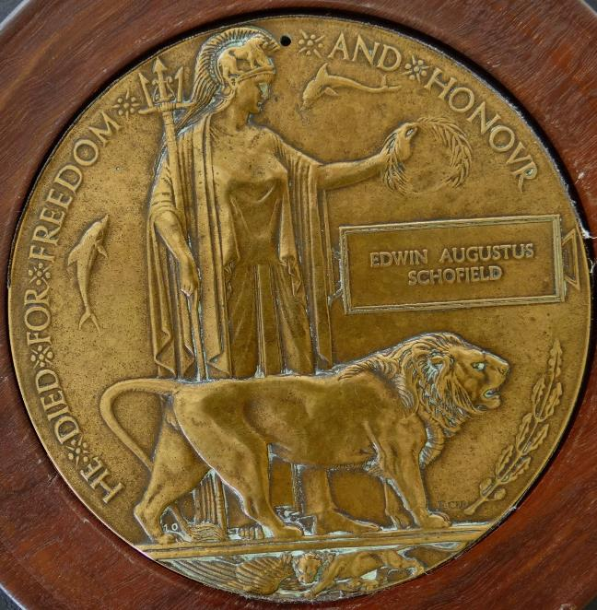
Memorial plaque – Edwin Schofield

Slide 37
Over the years we have commemorated ANZAC day with marches and services at the Cenotaph.

Slide 38
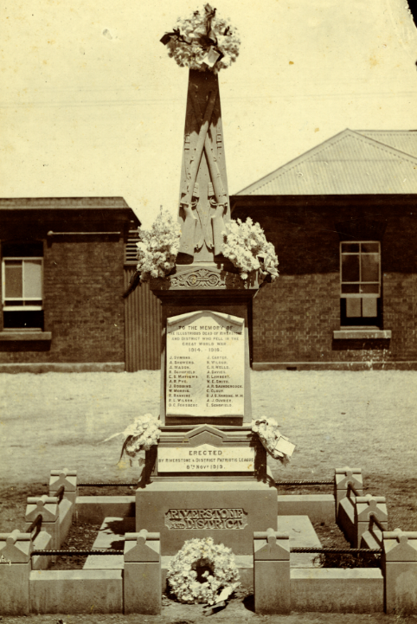

Slide 39
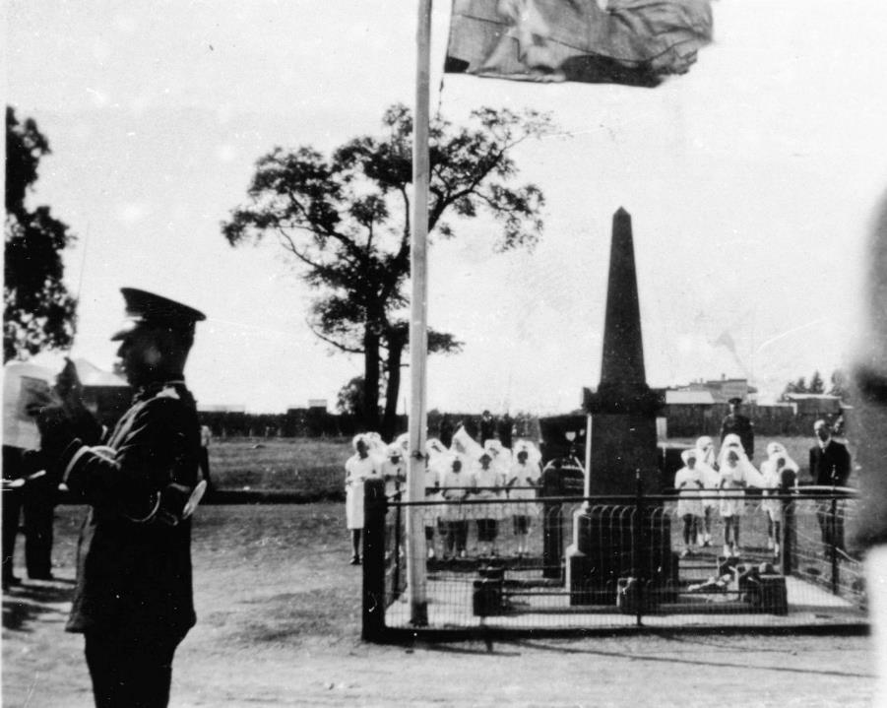

Slide 40
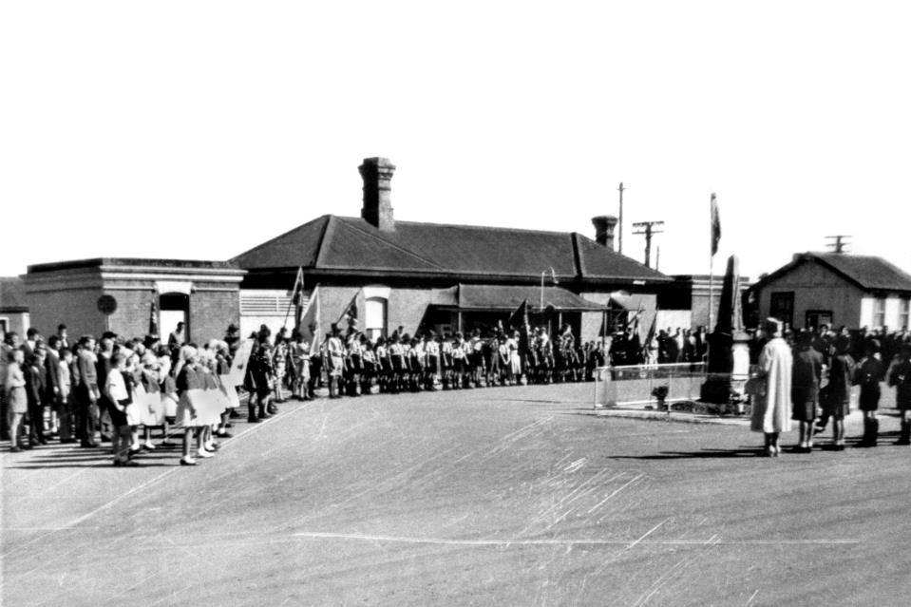

Slide 41
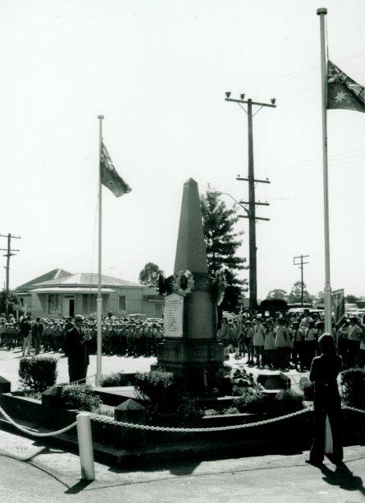

Slide 42
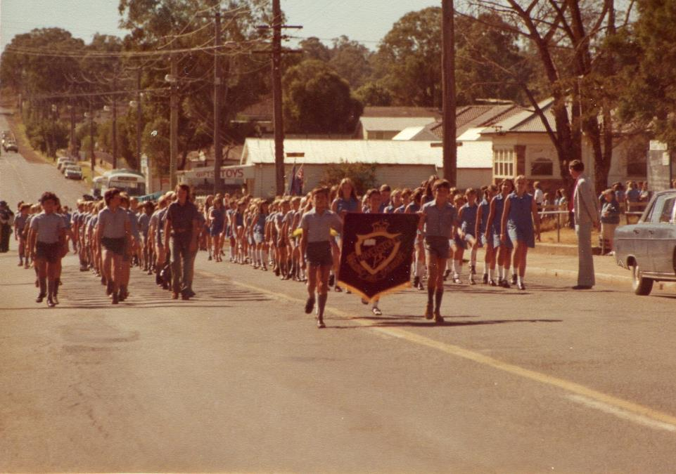
1970s

Slide 43
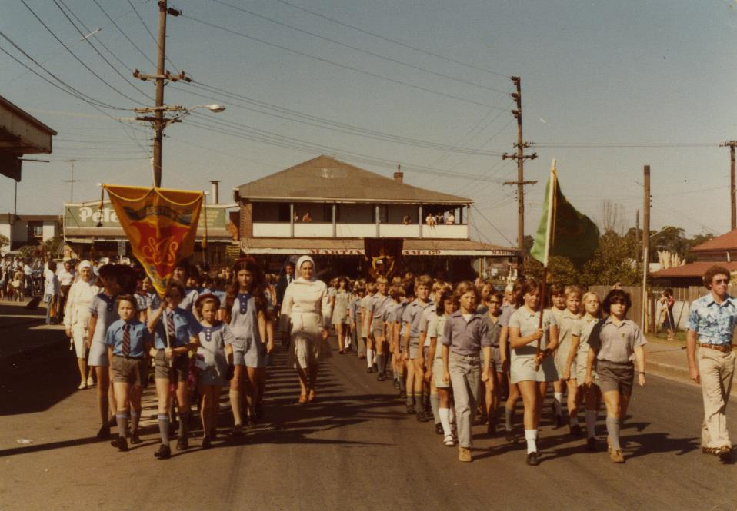
1970s

Slide 44
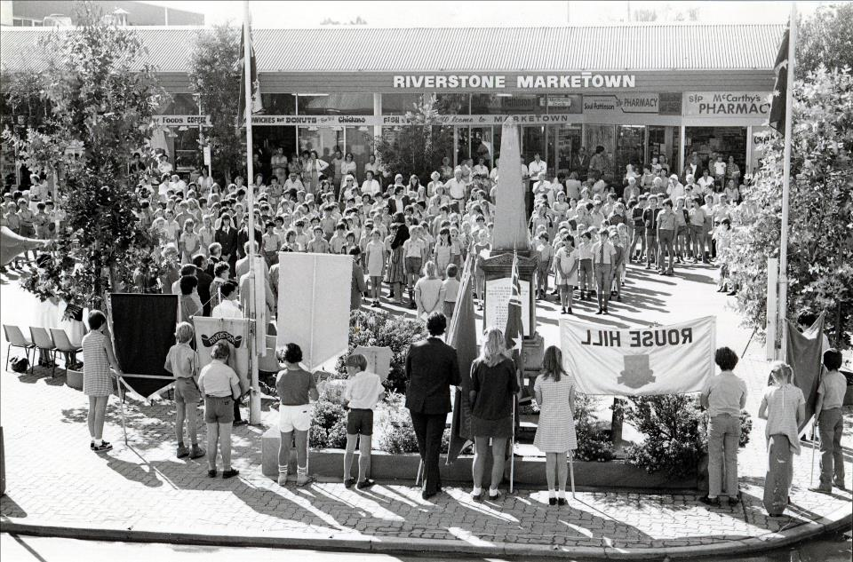
c1982

Slide 45
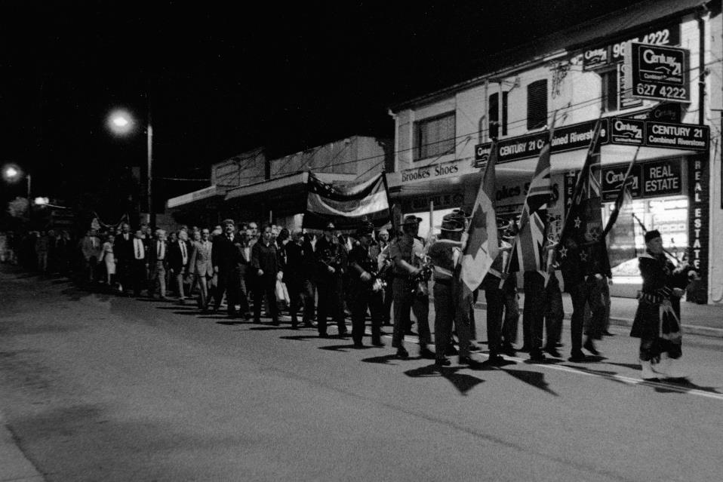
1996

Slide 46
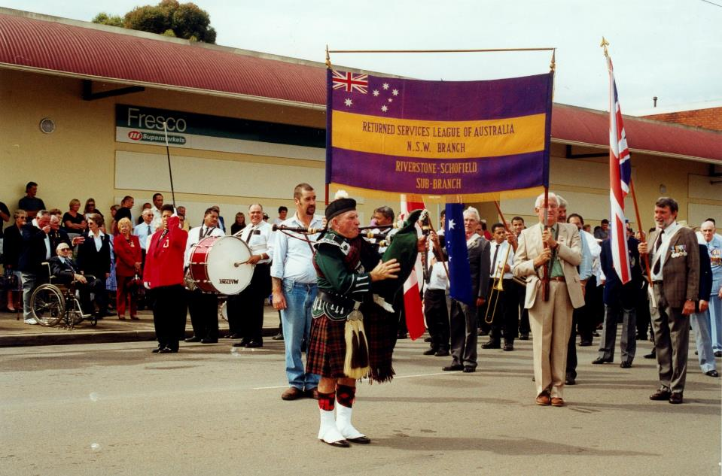

Slide 47
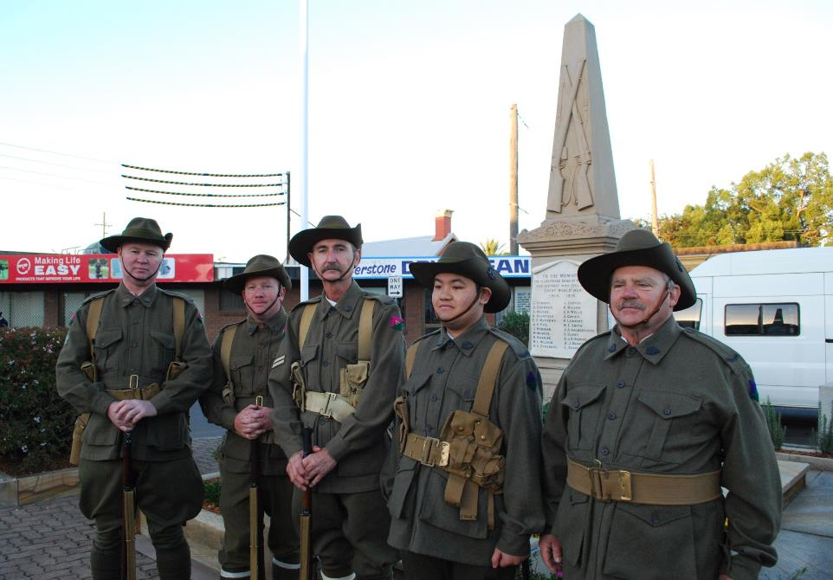
2013

Slide 48
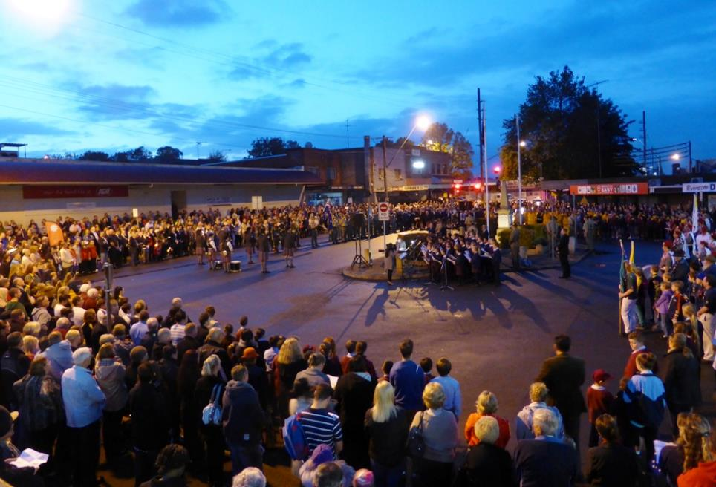
2014

Slide 49
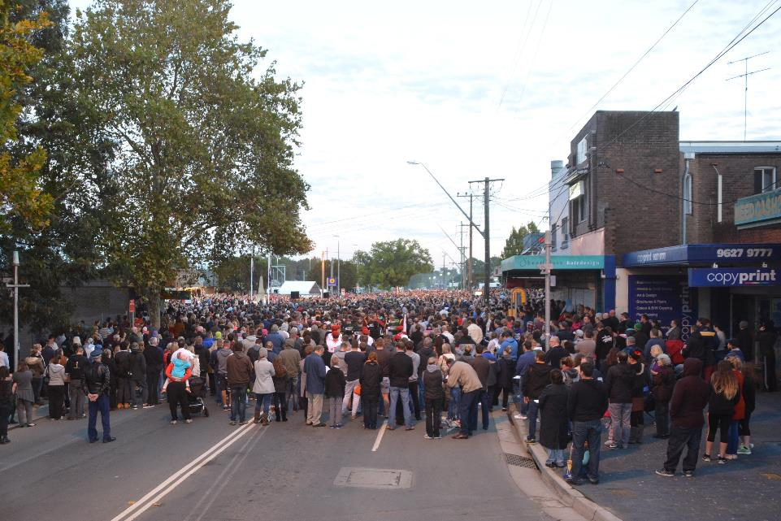
2015

Slide 50
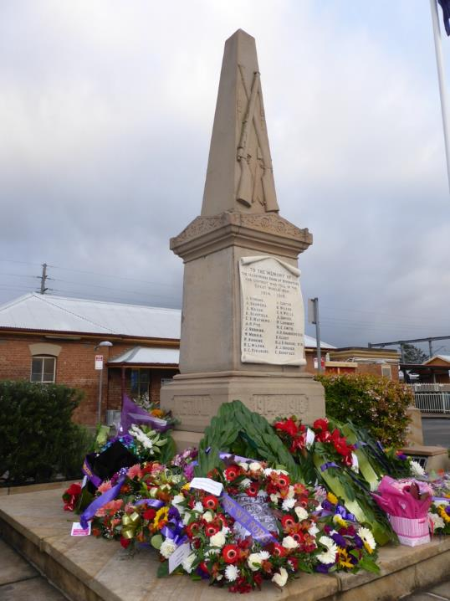

Slide 51
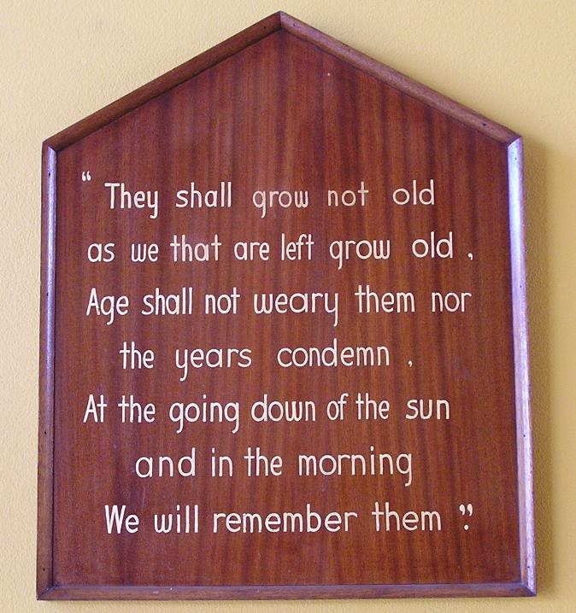

Slide 52
