Slide 1
Riverstone
and the
First World War

Slide 2
War was declared on 4 August 1914.

Slide 3
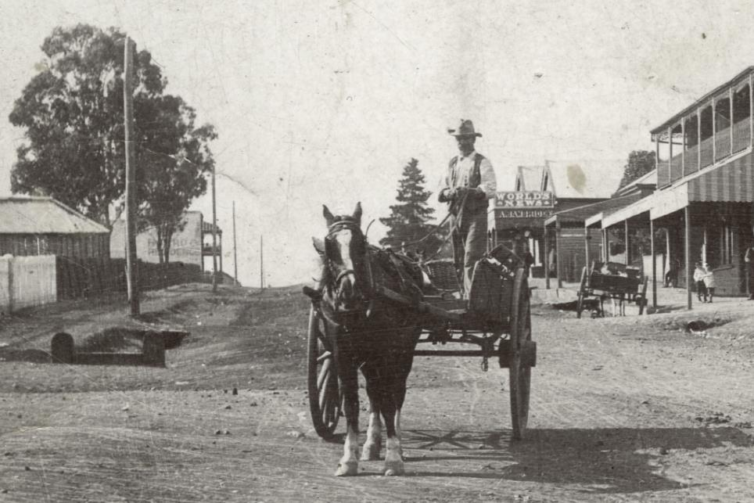
Garfield Road as it would have looked at the time.
Garfield Road as it would have looked at the time.
Notes:
Slide #1: Riverstone village collage

Slide 4
News spread via newspapers, word of mouth and the local telegraph service at the Post Office.

Slide 5
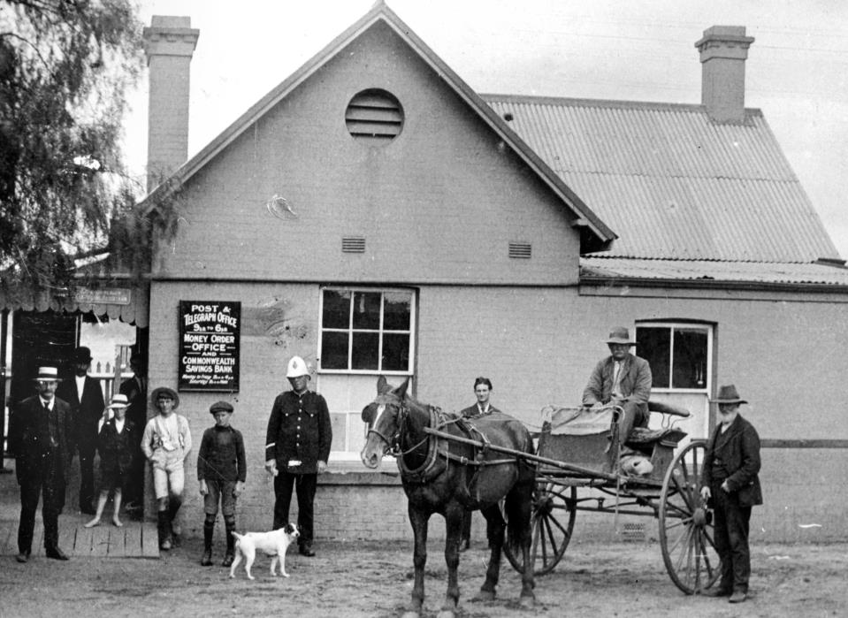
1916 Riverstone Post and Telegraph Office

Slide 6
Fred Clark & Alf Brookes were the first to sign up. They fought in the German Pacific colonies.

Slide 7
Fred Clark

Slide 8
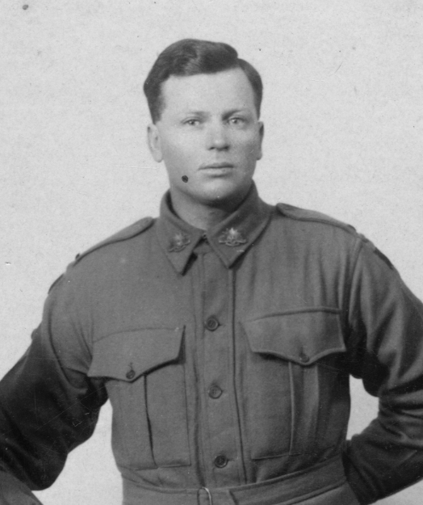
Herbert Davis was the first local to enlist in the Australian Imperial Force (AIF).

Slide 9
He was part of the first detachment that left Albany in WA on 1 November 1914.

Slide 10
17 men from the Riverstone district are known to have fought at Gallipoli.

Slide 11
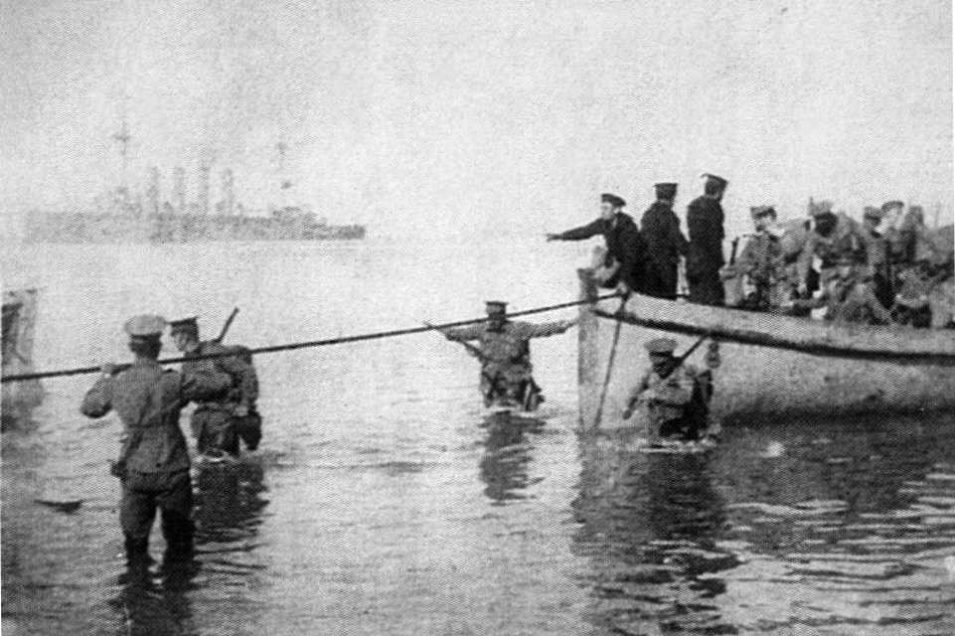
Landing at ANZAC Beach. Photo from Herbert Davis

Slide 12
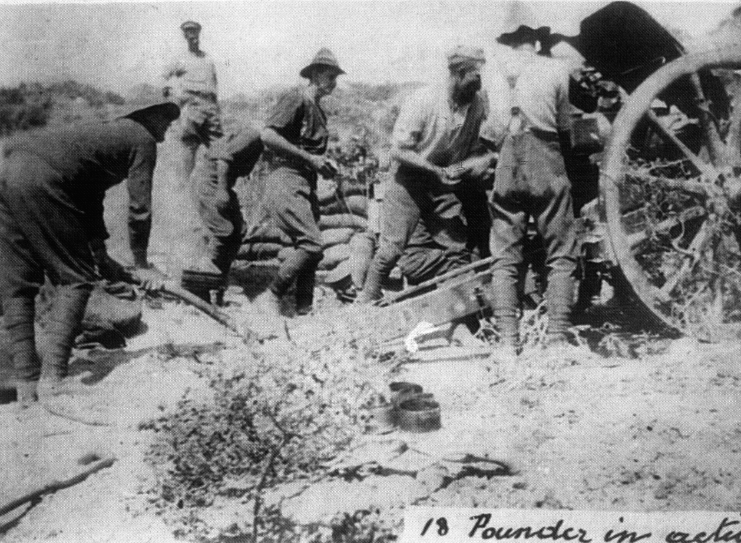
Landing at ANZAC Beach. Photo: Herbert Davis
18 Pound gun in action. Photo from Herbert Davis

Slide 13
Four were members of the Light Horse.
Bert Kenny
Frank White
Austin Smith
Arthur Brennan

Slide 14
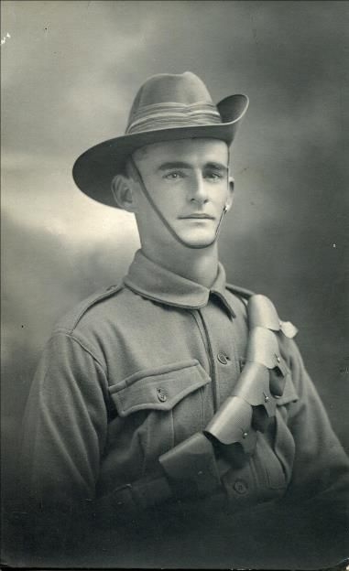
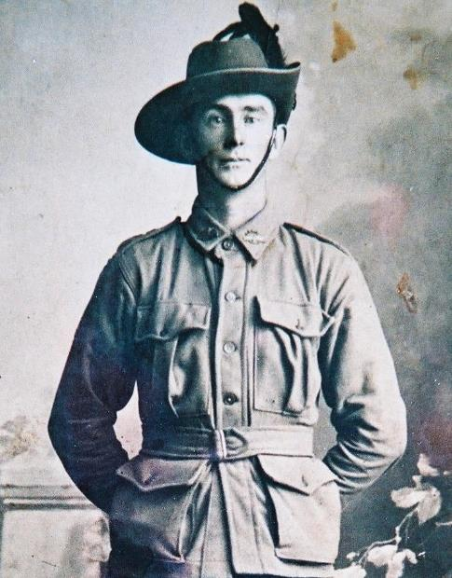
Bert Kenny
Austin Smith

Slide 15
One Riverstone soldier was killed at Gallipoli.

Slide 16
Archibald Showers died during the Battle of Lone Pine 6-9 August 1915.

Slide 17
His body was never identified.
A headstone was laid in the Lone Pine Cemetery.

Slide 18
Archibald’s Headstone

Slide 19
Some of the men who returned died from their injuries in the years just after the war.

Slide 20
Others suffered from their injuries for the rest of their lives.

Slide 21
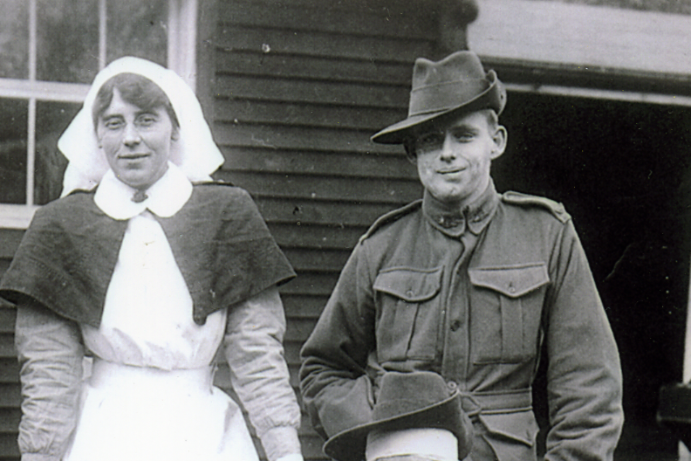
Soldier with facial injuries.

Slide 22
Casualty reports printed in newspapers and the return of injured men curbed enthusiasm to enlist.

Slide 23
Recruitment drives were held in the town to promote enlistment.

Slide 24
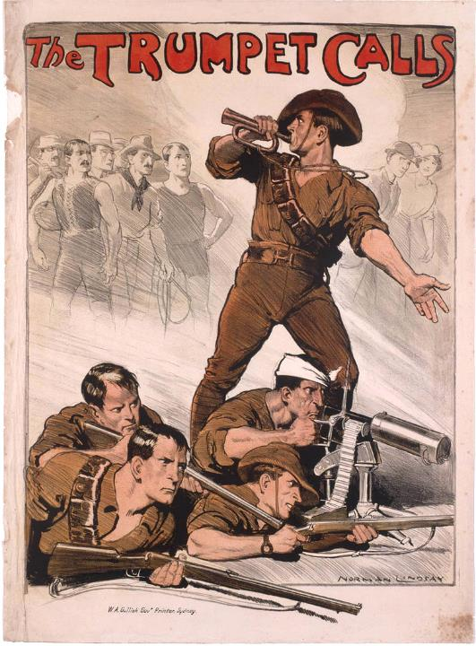

Slide 25
Women whose male relatives signed up were given special badges to wear day to day.
This put pressure on other women to have their menfolk join up as well.

Slide 26
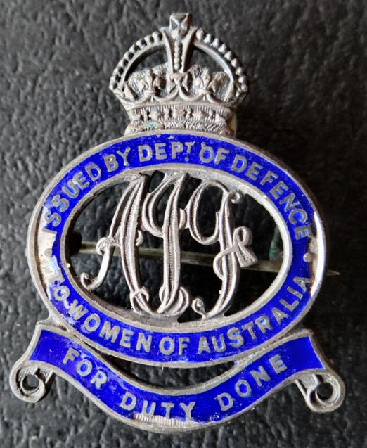
Mary Mason’s badge.

Slide 27
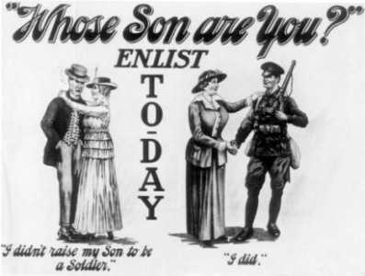

Slide 28
After Gallipoli, the focus moved to the Western Front.

Slide 29
More than 120 men from the local area enlisted during 1915-1918.

Slide 30
Farewell functions were held at the Oddfellows Hall.

Slide 31
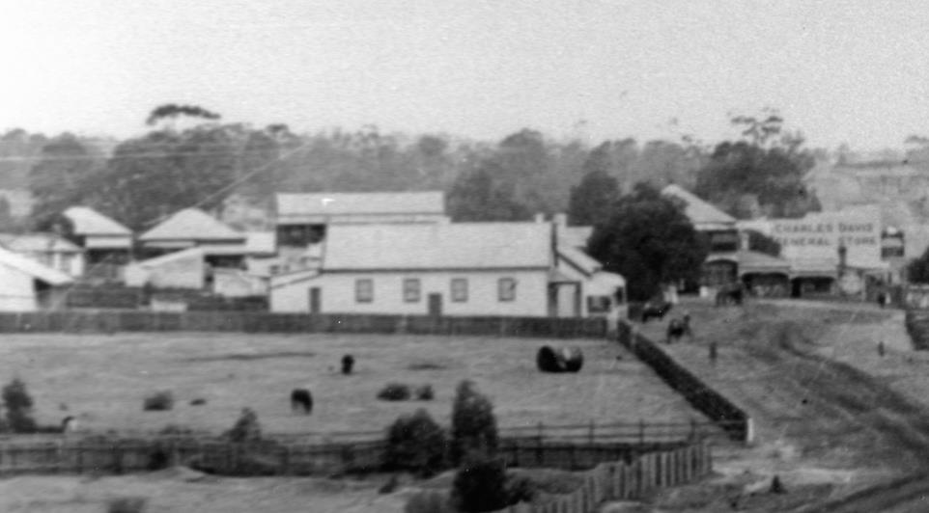
The Oddfellows Hall was located in Riverstone Pde.

Slide 32
Farewell gifts included watches, pipes and inscribed medallions.

Slide 33
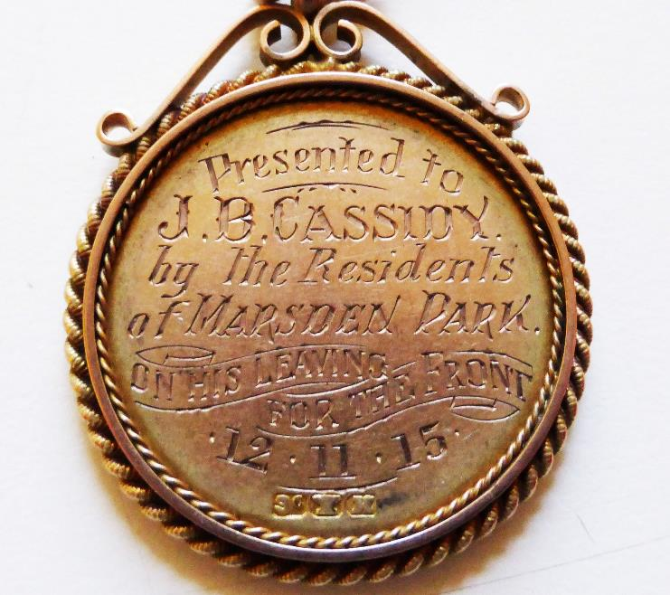
Medallion presented to J.B. Cassidy from the residents of Marsden Park.

Slide 34
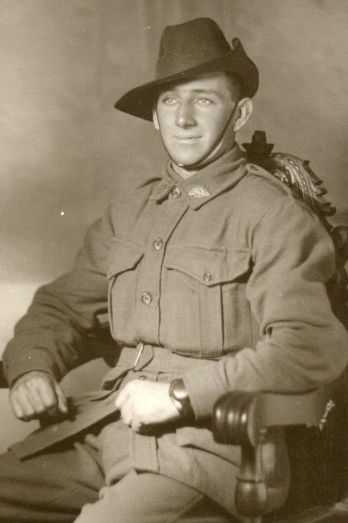
Soldier wearing a new watch, possibly a farewell gift.

Slide 35
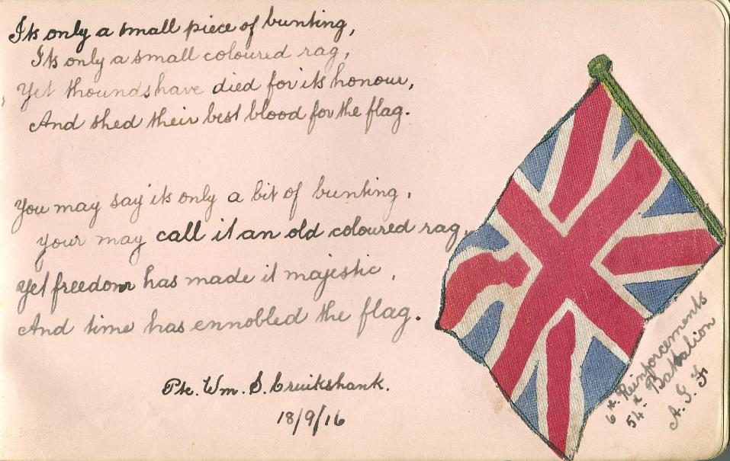
Autograph from W. Cruickshank before he left for the war.

Slide 36
After initial training the men sailed for the front on troopships.

Slide 37
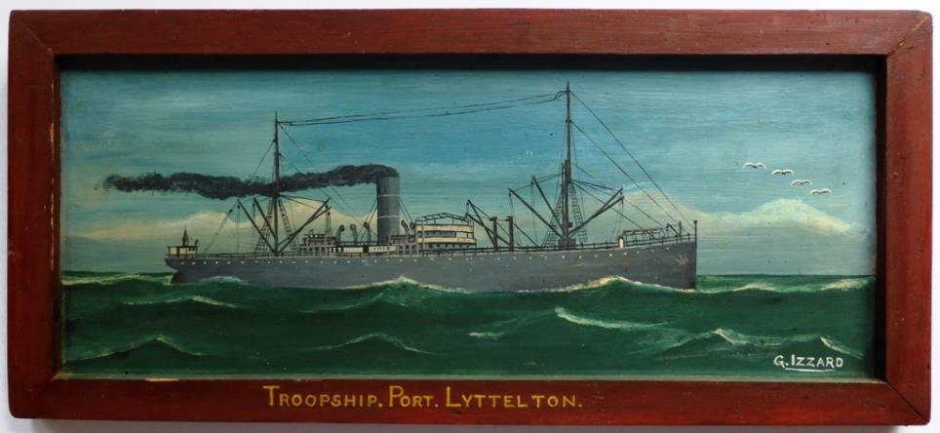
Local artist G. Izzard painted some of the ships they sailed on.

Slide 38
Families treasured photos of their loved ones.

Slide 39
W. Cruickshank
Fred Seaborn

Slide 40
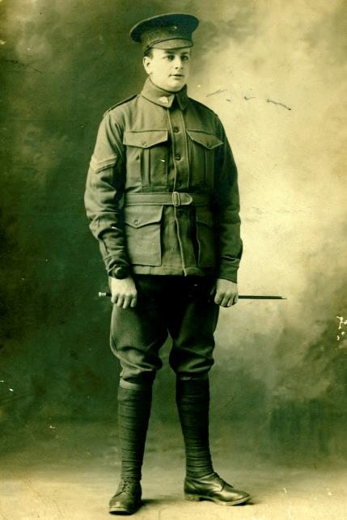
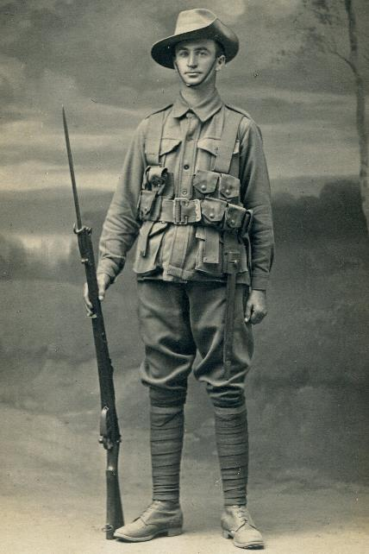
George Teale
Jack Cassidy

Slide 41
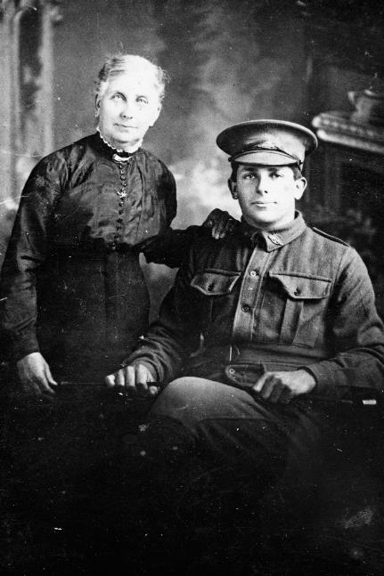
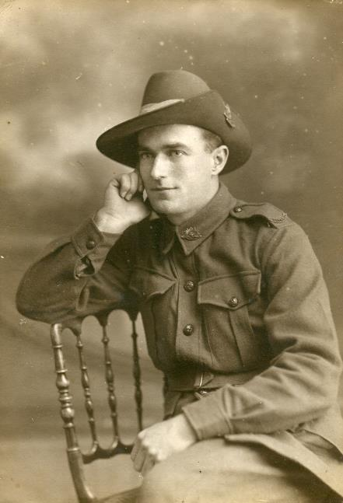
Claude Voysey
Joe Green

Slide 42
Women assisted through volunteer work, including fundraising events.

Slide 43
Branches of the Red Cross were quickly set up at Riverstone and Rouse Hill.

Slide 44
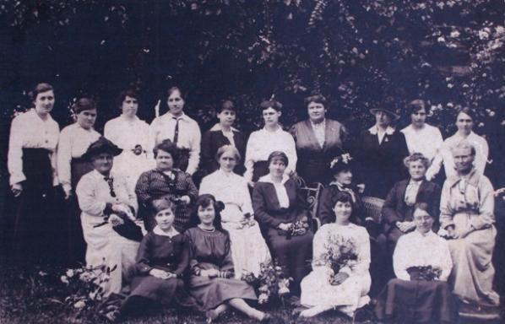
Rouse Hill - Kellyville branch of the Red Cross

Slide 45
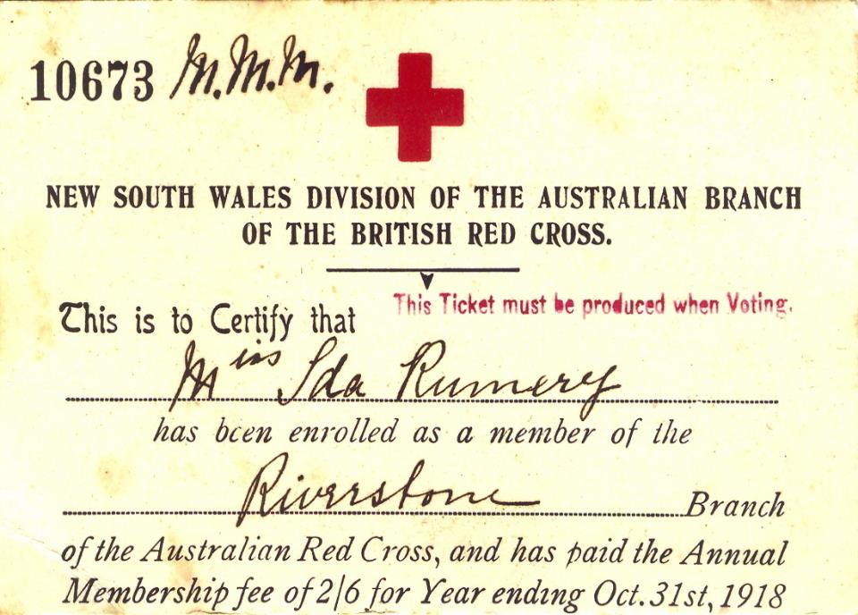

Slide 46
The troops were poorly supplied for the wet and cold conditions on the Western Front.

Slide 47
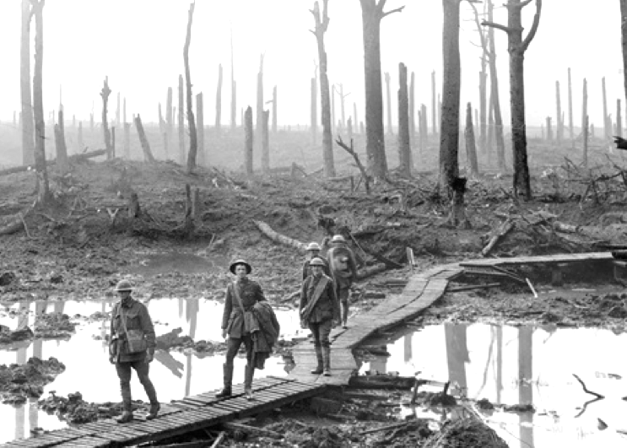
Chateau Wood Belgium October 1917

Slide 48
Fundraising events were held to buy items to send to the troops.

Slide 49
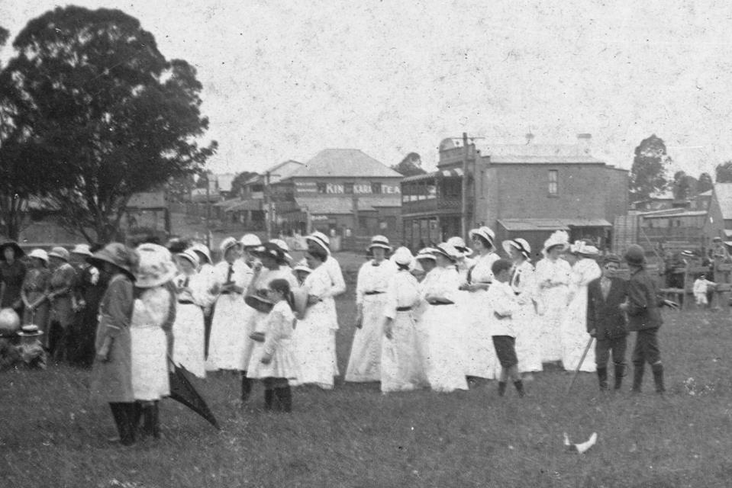
1914 cricket match in the Meatworks Paddocks.

Slide 50
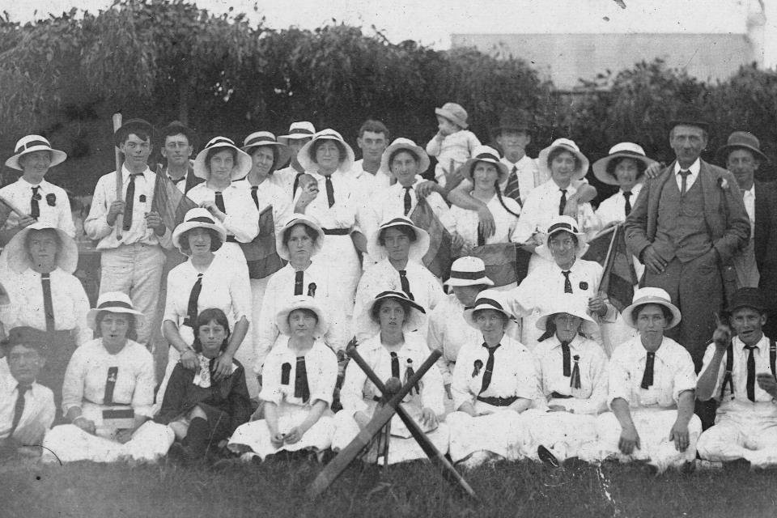
In 1914 a cricket team a women’s cricket team, using cricket bats, played a team of men, who used axe handles.

Slide 51
Items sent overseas included food and clothing, especially hand knitted socks.

Slide 52
Knitted socks and gloves.

Slide 53
Dry socks helped prevent “trench feet” which was caused by standing in water in the trenches.

Slide 54
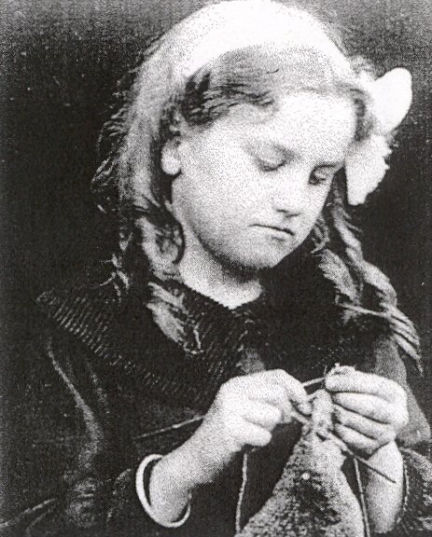
A young girl knits socks for the war effort.

Slide 55
The Home Comforts Fund sent food items such as fruit cake and biscuits.

Slide 57
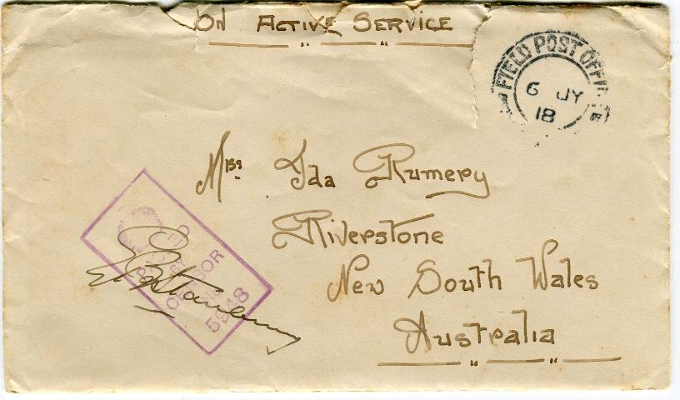
Soldiers wrote back with their thanks.

Slide 58
Injuries to people and damage to towns in France & Belgium were widespread.

Slide 59
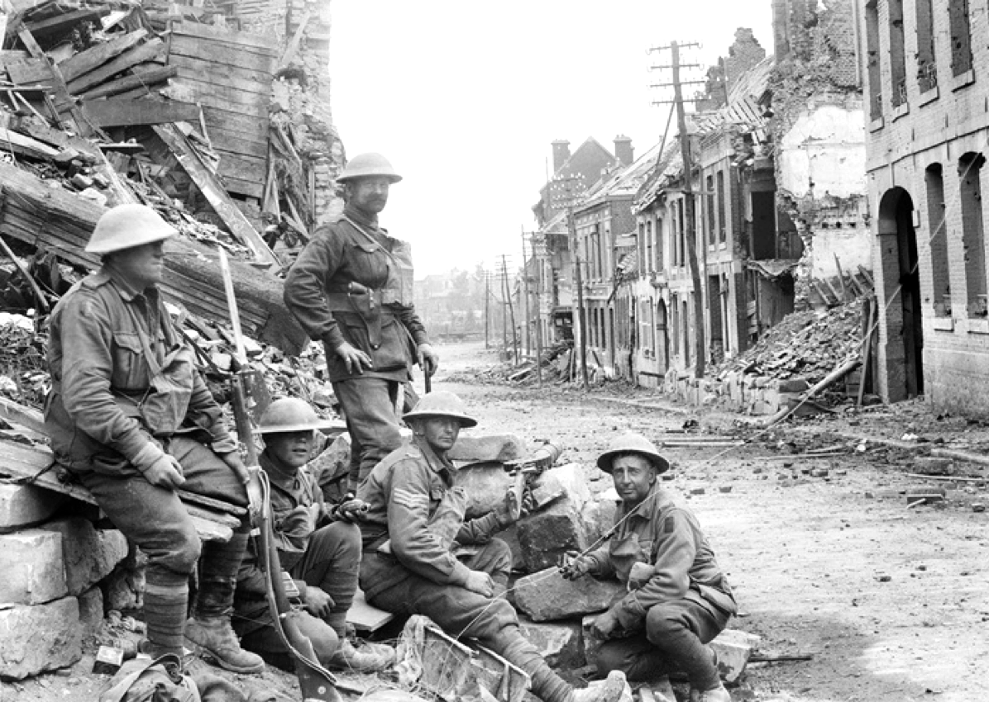
Western Front and photo
1918. Peronne in France.

Slide 60
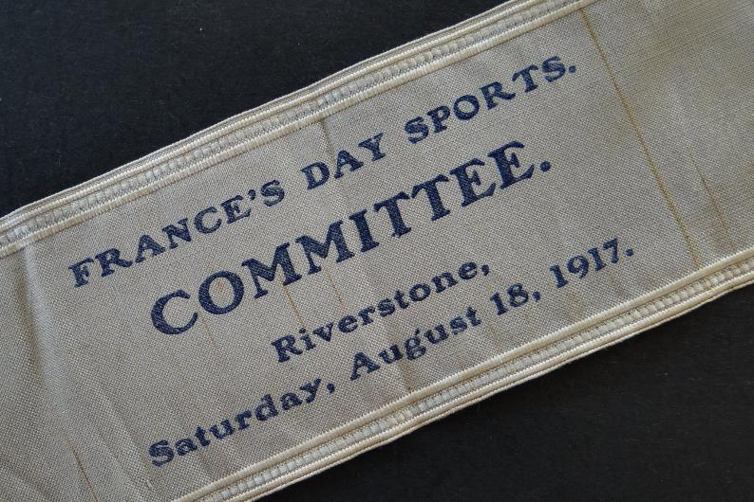
Funds were raised for the people of France & Belgium.

Slide 61
The sale of tin badges supported various causes.

Slide 62
During the war the men sent home letters, photographs and souvenirs.

Slide 63
As the mail came by sea, it took three months to arrive!

Slide 64
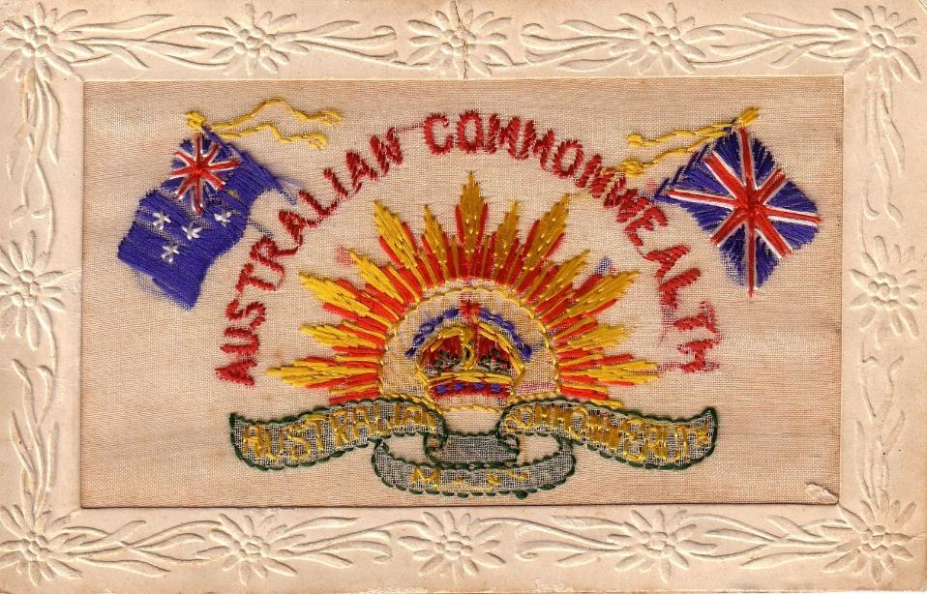

Slide 65
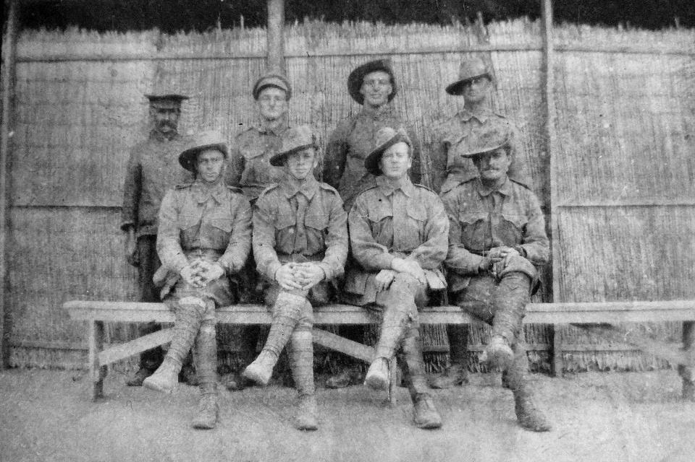
“Riverstone Boys in Egypt” 1916.

Slide 66
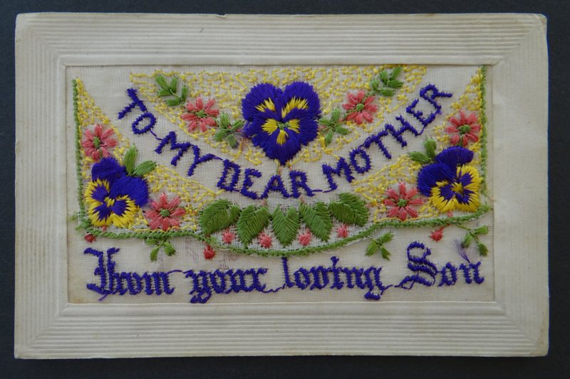

Slide 67
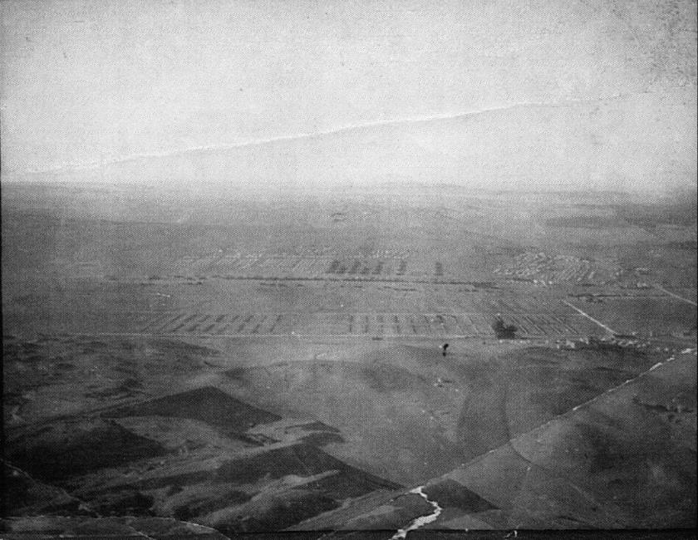
Mena Camp from pyramid in 1916

Slide 68
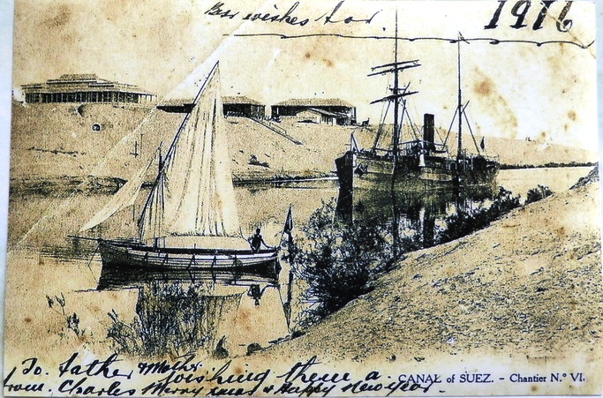
1916 Card from the Suez Canal

Slide 69
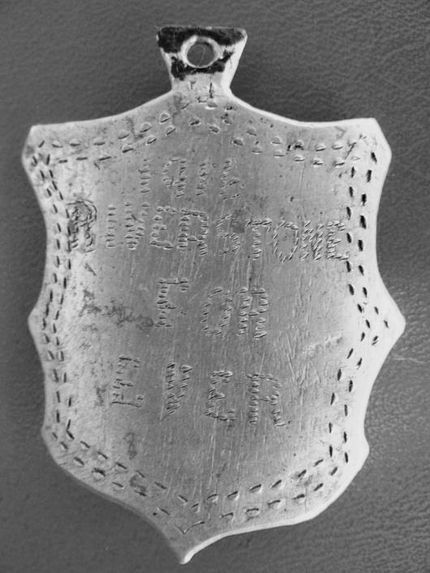
Trench art item which reads
1916
RIVERSTONE
FOR
EVER

Slide 70
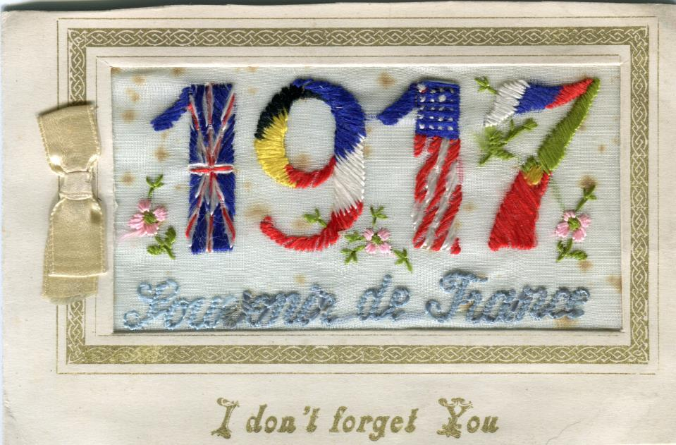

Slide 71
The men took part in offensives including the Somme, Flers, Pozieres, Fromelles, Bullecourt, Ypres, Amiens, Passchendale, and Villers-Bretonneux.

Slide 72
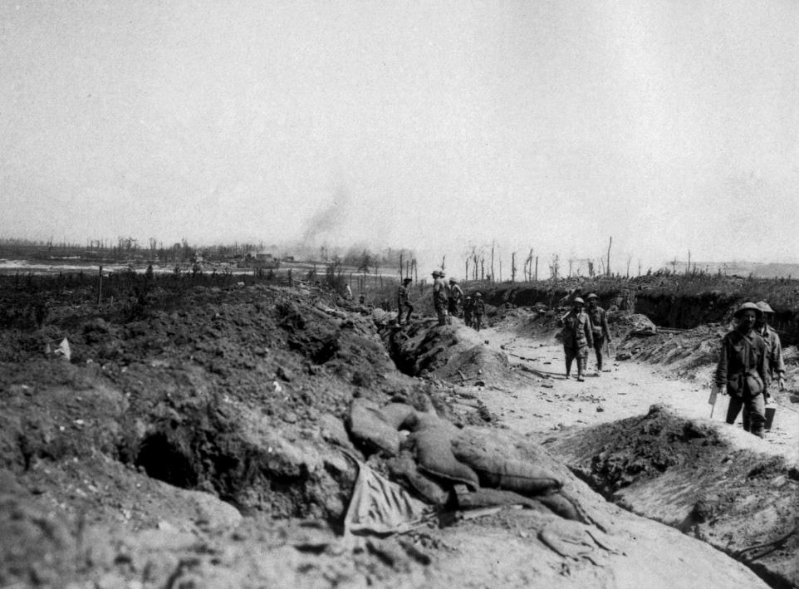

Slide 73
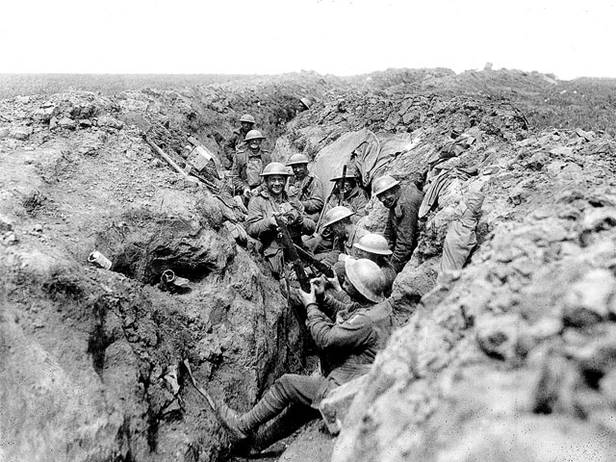

Slide 74
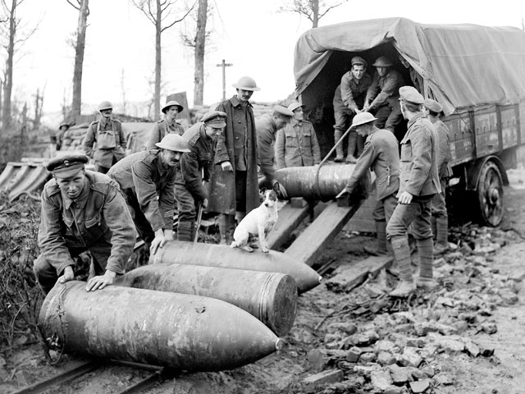

Slide 75
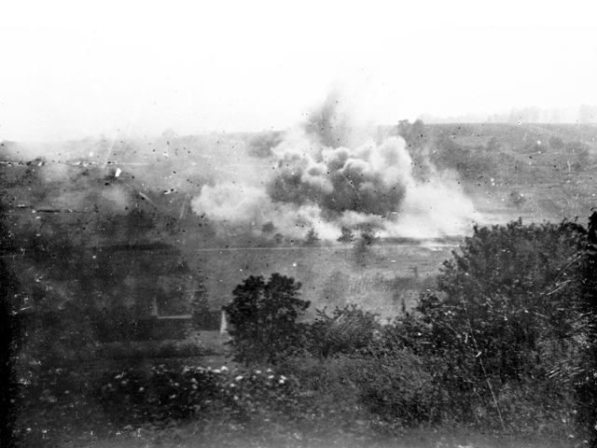

Slide 76
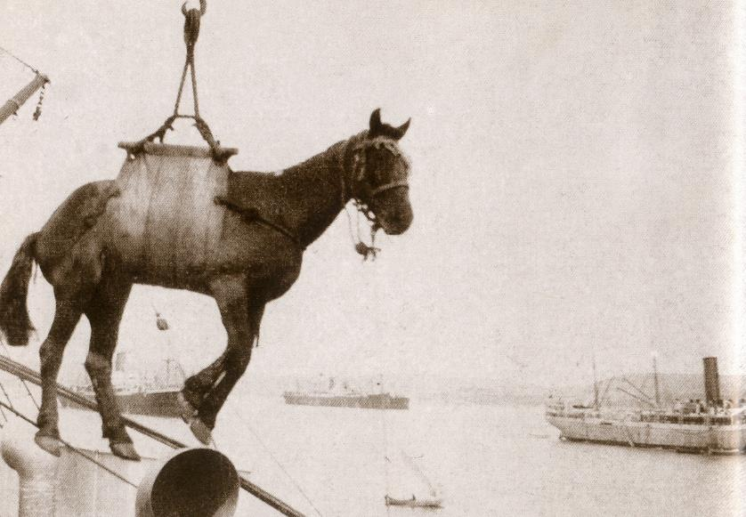
Horses were sent to the battlefields via transport ships.

Slide 77
Austin Smith took part in the Charge of the Light Horse at Beersheba.

Slide 78
He later recalled … I’ll never forget the roar of the shells and bombs etc exploding as we galloped up the street.

Slide 79
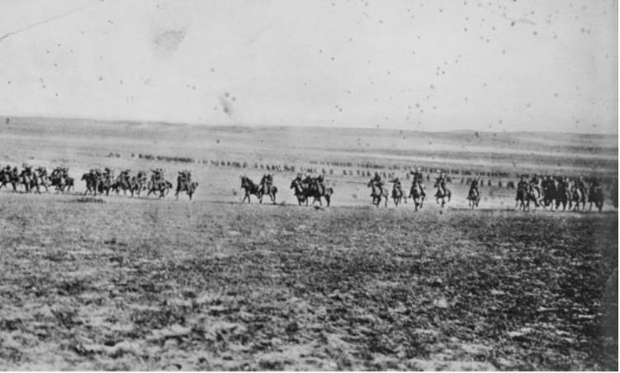

Slide 80
Injuries and disease were common. The men spent time in hospitals and convalescent homes.

Slide 81
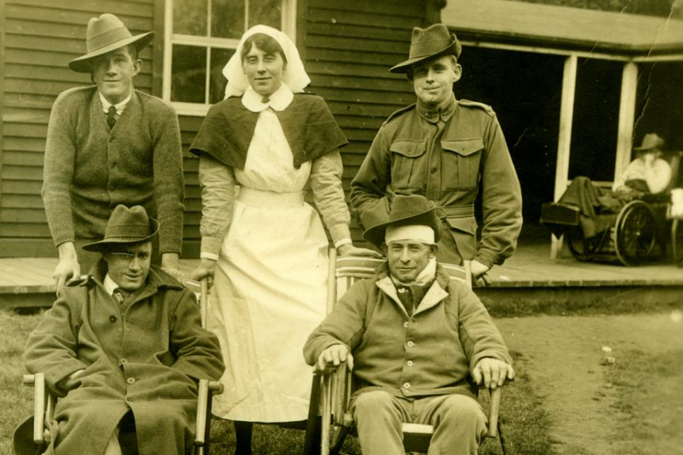
Joe Brown front right recovering - France.

Slide 82
A special honour board was unveiled at the Riverstone railway station on 28 September 1918.

Slide 83
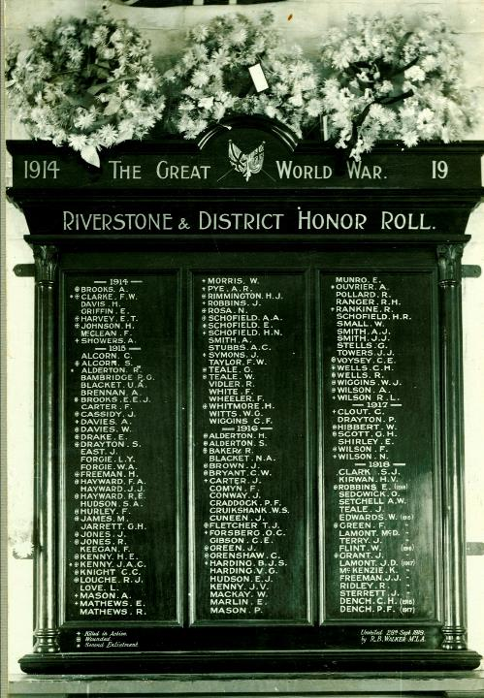

Slide 84
The task of informing families of the death of their loved one rested with ministers and priests.

Slide 85
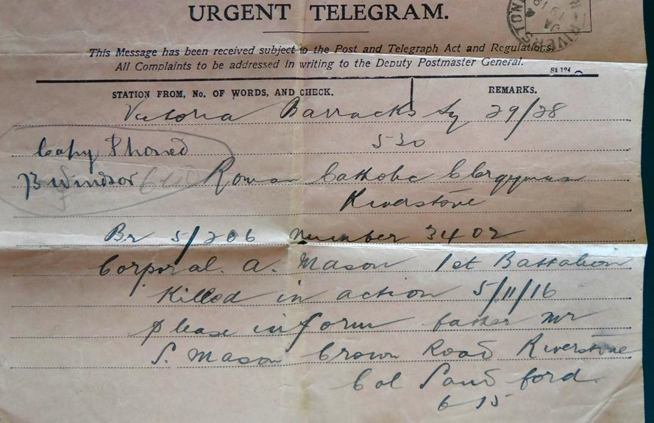
Telegram to local priest asking him to advise
Sam Mason of the death of his son.

Slide 86
“In peace the sons bury their fathers,
but in war the fathers bury their sons.”

Slide 87
The Armistice was signed on 11 November 1918.

